Slide 1
What If?
Questions about face coverings from the child’s perspective
Illinois Early Learning Project
October 2020

Slide 2
What If?
Children often wonder “what if?” when it comes to face coverings. Share these slides with young children as talking points to help them understand the proper use and wearing of face coverings.

Slide 3
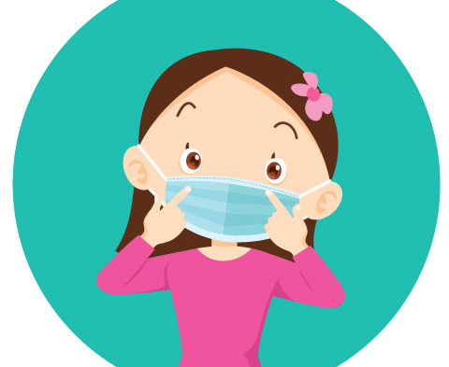
What if I have an itch?
Sometimes you might feel an itch on your face; this is normal.
Scratch that itch, then wash your hands.

Slide 4
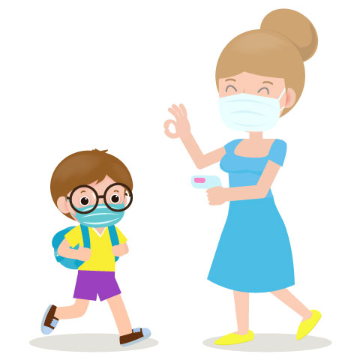
What if I sneeze or need a tissue?
Tell your adult that you sneezed and ask to take your mask off.
Grab your ear loops or straps and take your mask off.
Use a tissue to blow your nose and wipe your face. An adult will let you know if you need a new mask.
Put your mask on. Wash your hands.

Slide 5
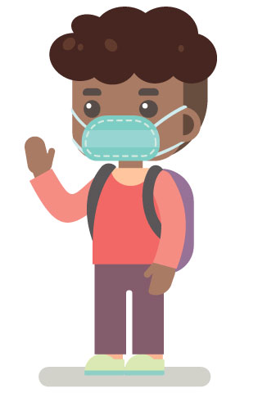
What if I want to eat or drink?
Ask an adult if you can take off your mask to eat or drink.
Wash your hands before you eat or drink. Grab your ear loops or straps and take your mask off. Put your mask where an adult tells you to put it.
When you are done eating or drinking, put your mask back on. Wash your hands again.

Slide 6
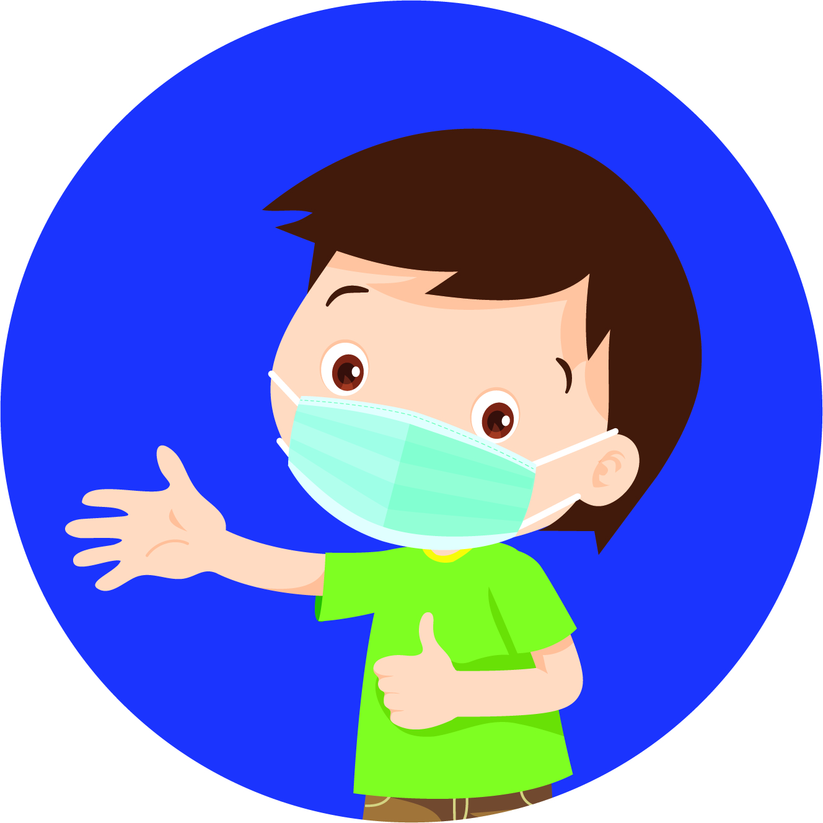
What if a friend wants to touch my mask?
If a friend tries to touch your mask, you can say, “No, thank you” and move away.
If you touch another friend’s mask, you are spreading germs.
We want to stay safe and healthy, so we keep our hands to ourselves.

Slide 7
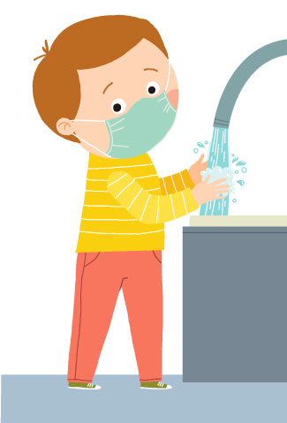
What if a friend teases me about my mask?
If a friend says something unkind about your mask, you can ignore them or ask an adult for help.
It is okay to feel sad or angry. Sometimes people say unkind words.
You can talk to an adult about how you are feeling. You can choose to move away and play near someone else.
Masks keep us all safe!

Slide 8
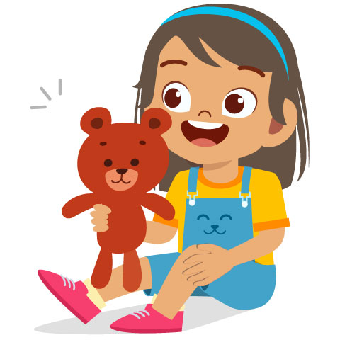
What if someone is not wearing a mask?
In many places such as school, stores, and the doctor’s office, we wear masks to keep everyone safe. In some places, we might not wear a mask, such as at home or in the back yard.
You can talk to an adult if you are worried when you see someone without a mask. You can keep people safe by wearing your mask!

